Slide 1



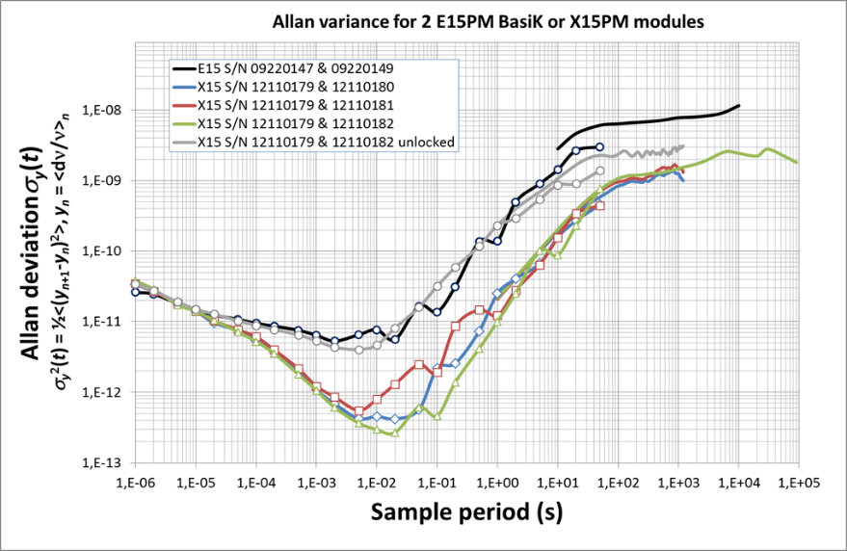
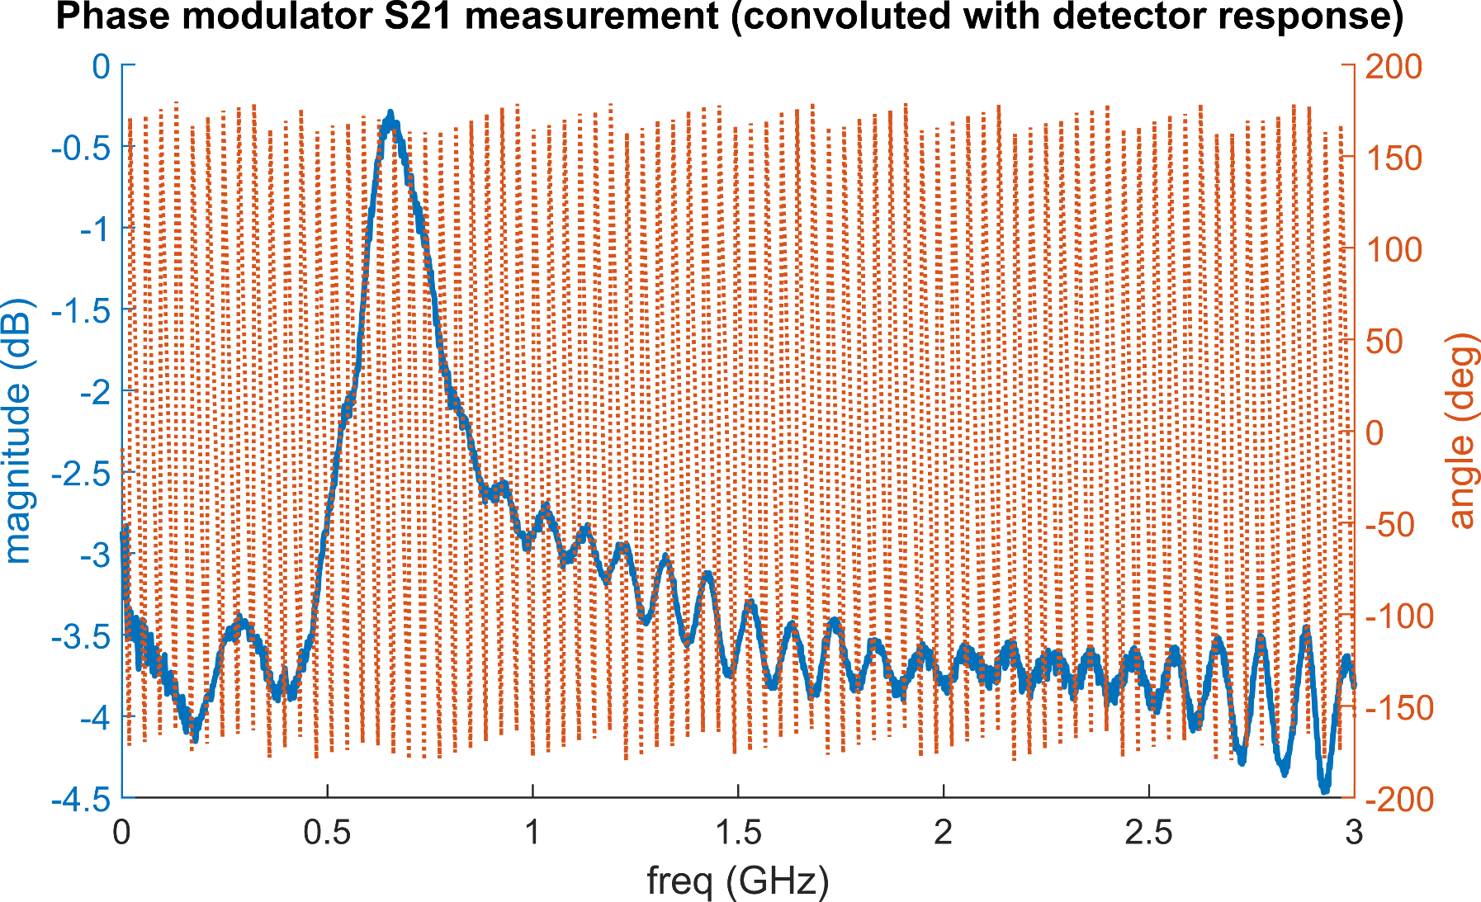
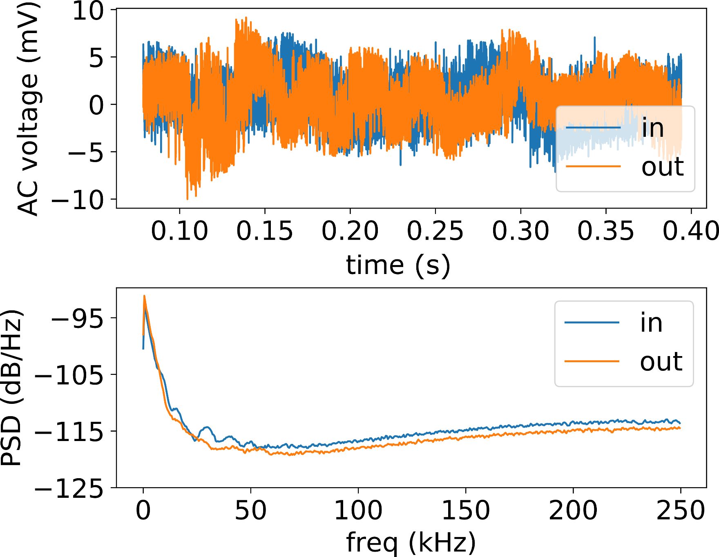
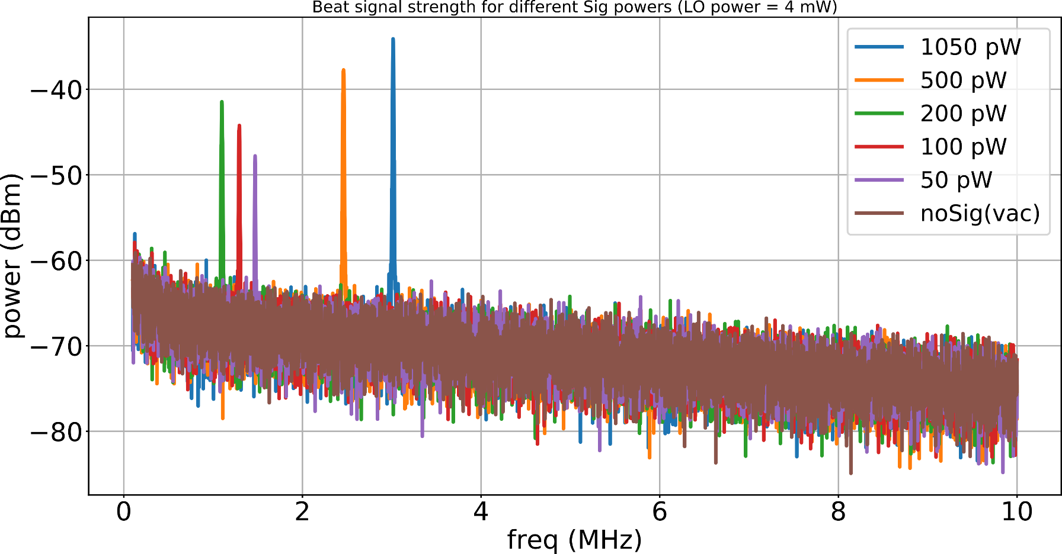
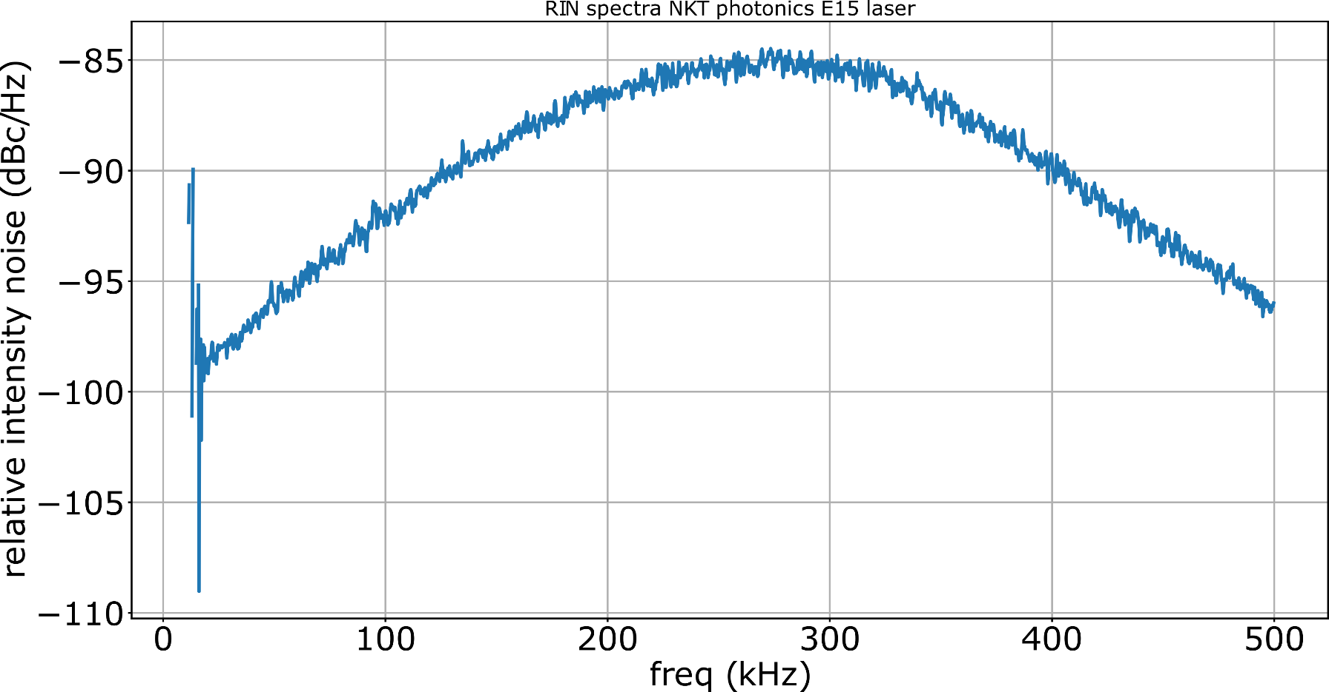
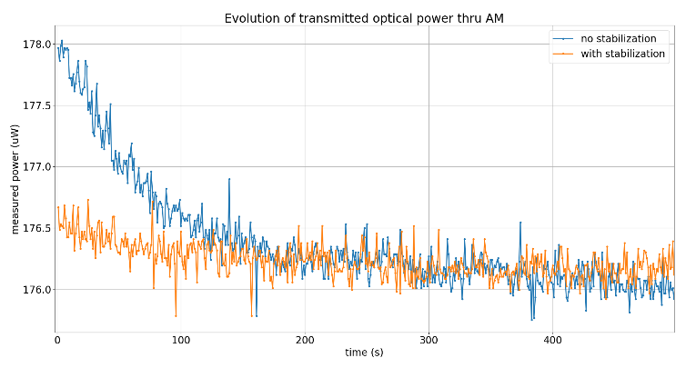
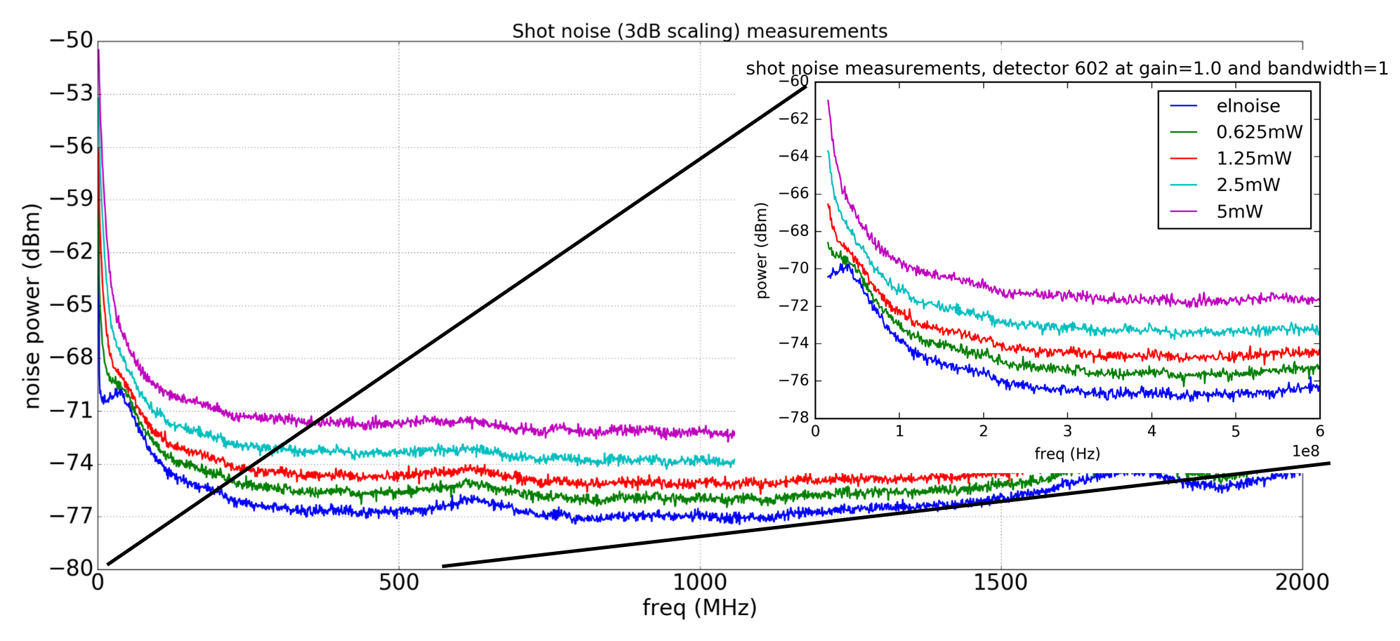
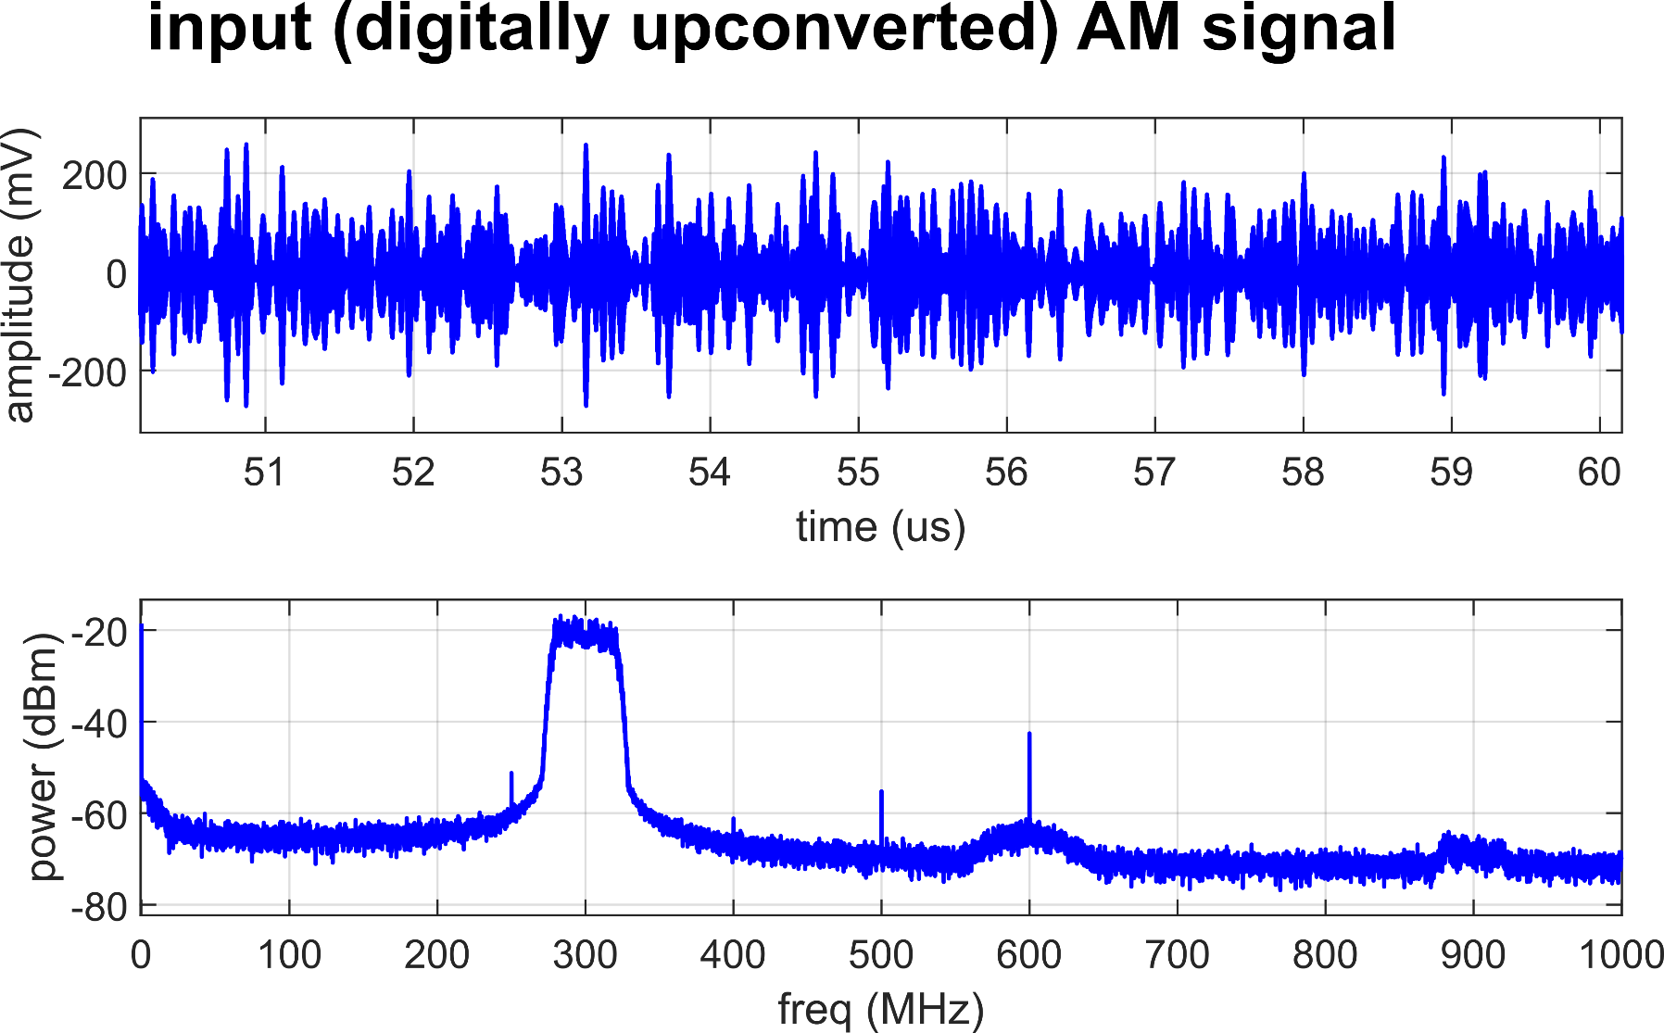
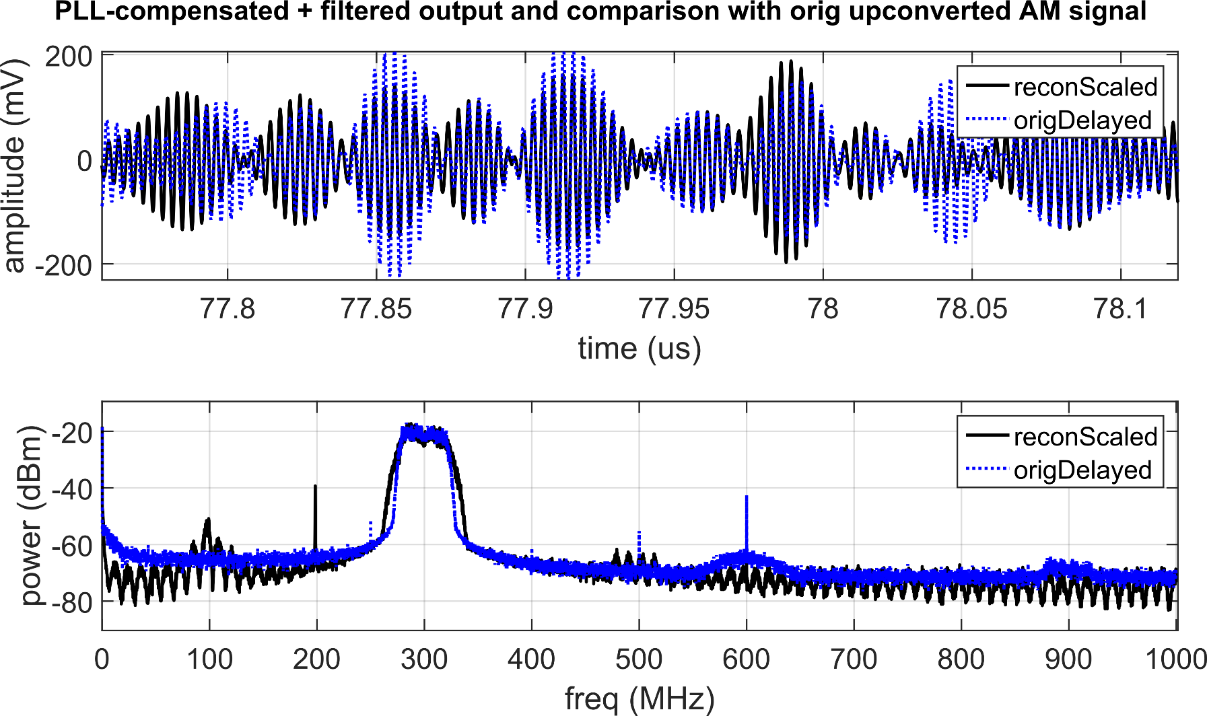
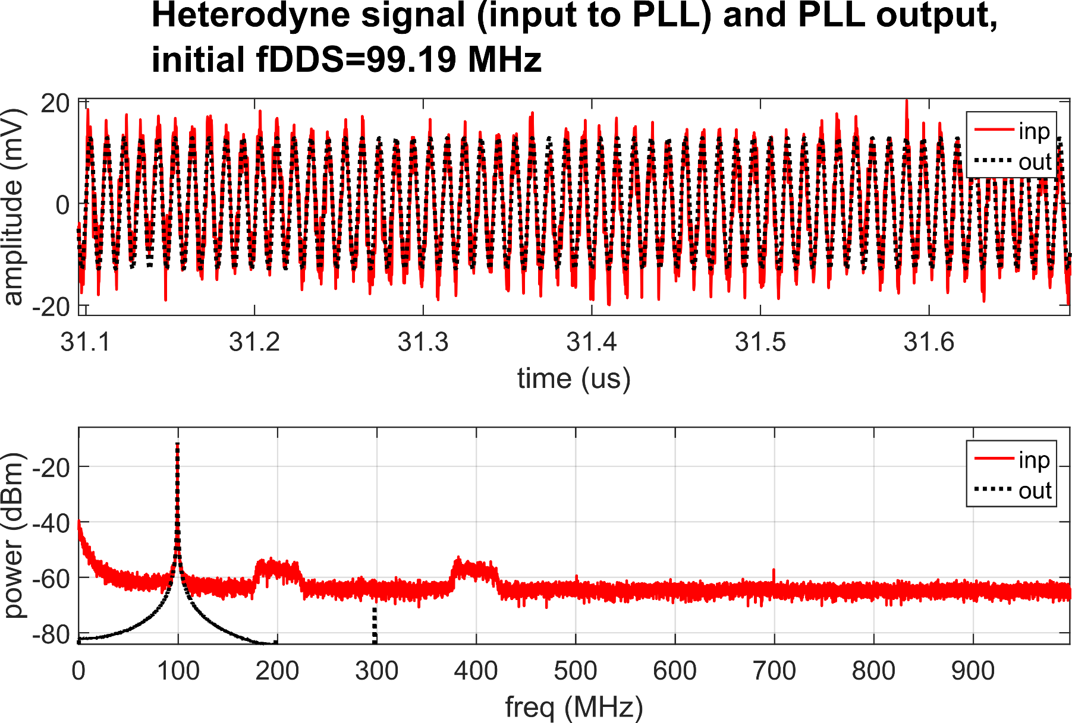
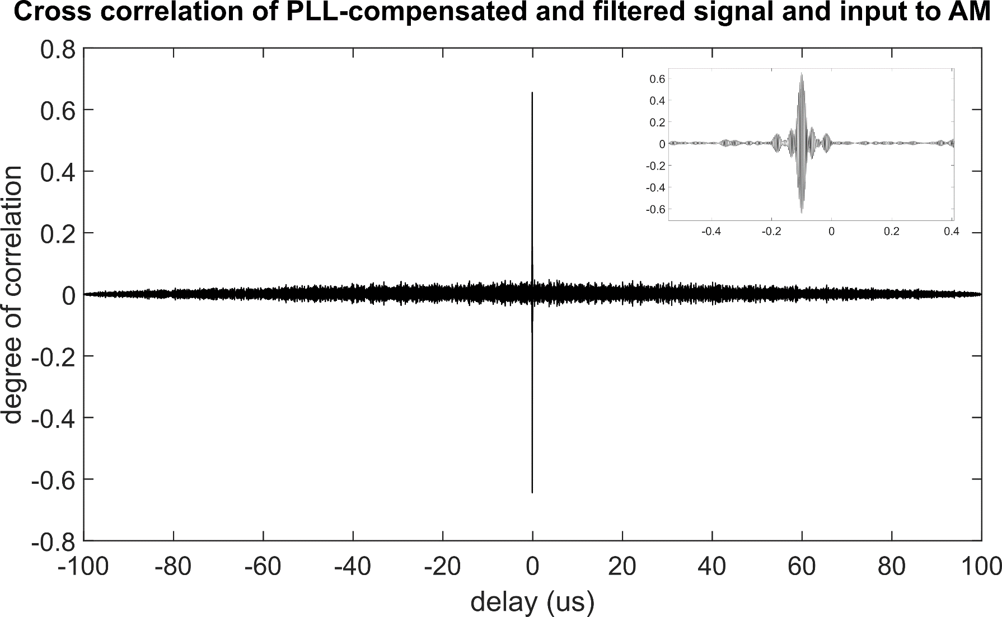
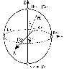
Investigating feasibility of broadband continuous variable quantum key distribution in telecom fibers with local local oscillator
N. Jain,¹ C.S. Jacobsen, ¹ D. Solar Nikolic,¹ A. Kordts,¹ C. Lupo,²
R. Grigoryan,¹ T. Pedersen,³ S. Pirandola,^{2,4} T. Gehring,¹ and U.L. Andersen¹
¹Department of Physics, DTU, 2800 Kongens Lyngby, Denmark, ²York Centre for Quantum Technologies (YCQT), University of York, York YO10 5GH, ³Cryptomathic A/S, Jaegergardsgale 118, 8000 Aarhus, Denmark, ⁴Computer Science, University of York, York YO10 5GH, United Kingdom
Introduction
Transmitted LO vs. local LO
The use of continuous variable quantum information carriers, instead of qubits, constitutes a powerful alternative approach for quantum key distribution (QKD). CV-QKD protocols present the major advantage that they only require standard telecommunication technology such as lasers, fibers, and in particular, widely used coherent detection techniques. The best understood CV-QKD protocols, in terms of security proofs and practical implementation, are one-way protocols using coherent states with Gaussian modulation. These protocols are proved to be secure against collective Gaussian attacks in finite size regime.
CV-QKD systems employ receivers which perform phase-sensitive detection using an optical beam called local oscillator whose phase drift with respect to the emitter must be precisely controlled and estimated. In most implementations the transmitted local oscillator (TLO) design is used. In order to lift important limitations of TLO, a new method implementing local local oscillator (LLO) is used.
Heterodyne detection with LLO
While in homodyne detection local oscillator needs to be exactly the same frequency as the carrier of quantum signal, in heterodyne detection one can freely manipulate the LO frequency. Output current of the homodyne receiver (with the detuned LO) is:
EQUATION
The expression assumes negligible phase noise and small modulation depths.
TLO
LLO
Stable relative phase between quantum signal and LO at the receiver
Security weakness by manipulating LO intensity or wavelength on the quantum channel
LO intensity limitation at the receiver due to propagation losses and non- linear effects in fibers
Difficulty in estimating the relative phase between quantum signal and LO; more complicated phase correction using reference pulses needs to be employed
LO can be fully trusted, security loopholes closed
No limitation on LO intensity at the receiver
Current setup and component characterization
real LO
laser
VATT
PMF
SMF
AWG/
FPGA board
PM
AM
VATT
heterodyne detection
(ω_{b} ≠ 0)
-
(Demodulation &)
Oscilloscope/ADC
laser
NKT Photonics X15 and E15 lasers
Broadband coding may require a thorough
pre-characterization of the modulators and
detector response (transfer function) in the
frequency band of interest.
Results
ADC, clock recovery,
demodulation,
reconstruction etc.
Data processing performed offline in MATLAB with digital PLL for recovering the modulated data
The current setup employs amplitude and phase modulators which create double sideband
Future steps
PMF
SMF
QRNG
FPGA
(RF mod)
VATT
Security analysis
The future setup will use single-sideband modulation for better spectral efficiency and closing potential security loopholes
Introduction of pilot signals for clock recovery, multiplexed in time with the quantum signal
Carrier synchronization on receiver side
Replacing AWG and oscilloscope with FPGA DAC/ADC suite for online signal generation and recovery
laser
IQmod
A composable security proof for the most general attacks in Gaussian CV-QKD systems is still an open problem
It is proved that the system is secure against collective attacks for continuous Gaussian modulation of coherent states; this is very important result since general coherent attacks will be possible only with very advanced quantum adversary in, what is believed, not so near future
The main focus of our theoretical research is estimating final key length taking into account finite block length and inevitable discretization of Gaussian modulation
Current security proof provides an expression for secret key length:
EQUATION FROM COSMO
½
ADC, clock recovery,
demodulation,
reconstruction etc.
dynamic polarization
controller
heterodyne detection
(ω_{b} ≠ 0)
laser
VATT
[1]
References

